Slide 1

Notes:
When COVID-19 started to spread everywhere,a group of volunteers from around the world got together. single tweet calling for people to help Ethiopia, The Ethiopian COVID-19 Response Team ECRT born March 16th 2020.

Slide 2
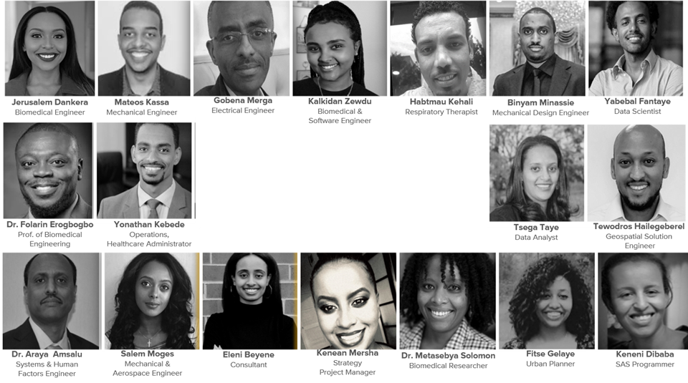
Meet Our Team
Notes:
These are the team members of the healthcare project workstreams. Skills highlight: Biomedical, Mechanical, Electrical, Aerospace Engineers, Healthcare professionals, Project Managers, Consultants

Slide 3
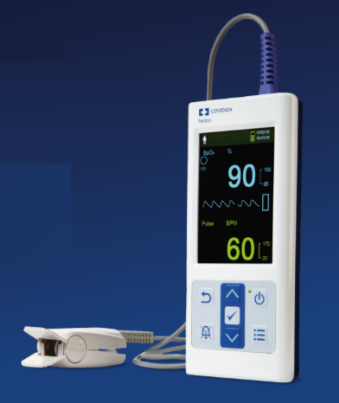
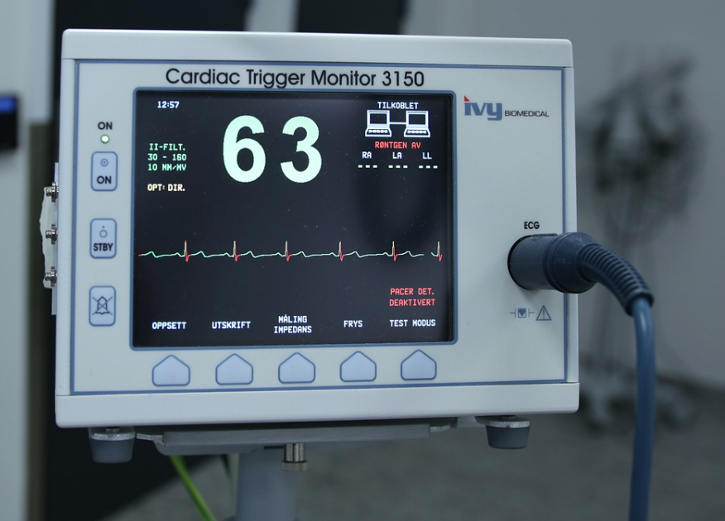
Ventilator & Medical Devices.

Slide 4
Projects
Local Manufacturing
Refurbished Devices
Training Module
Medical Equipment Maintenance
Spirowave Design
Medical Device Donations
Local Prototype
Notes:
Maintenance
Pending funding.
Refurbished Devices
Pending funding.
Local Manufacturing
Pending funding.
Training Modules (led by @Yonathan)
Local Prototypes
Medical Device Donation (led by @Yonathan at #proj-device-donations)

Slide 5
Medical Device Shortage
Dependence on Importing
Challenges Immediate and Systemic
Scarcity for Devices Maintenance
Limited Frontline Training
Project Medical Devices

Slide 6

Create a Medical Device Product Development
Framework
Mentor 3 Grant Winner Engineering Teams
ECRT: Provide Resources and Guidance
Under ECRT Subject Matter Experts
Partnership
Accelerator Lab
Set up Lab For Reliability and Functionality Testing of Prototypes
Other Health Tech Projects
tackle Covid-19 challenges with local innovation
ECRT has won a grant for proposed plan
If interested, reach out to Mateos or Jerusalem
Local Manufacturing Initiative
Notes:
Local Manufacturing Initiative
Partnership with UNDP Accelerator Lab Ethiopia - to tackle Covid-19 challenges with local solutions
https://www.et.undp.org/content/ethiopia/en/home/blog/2020/covid-19--tackling-the-challenge-with-local-solutions.html
Create a Standard Medical Device Product Development Framework For the Entrepreneur Community
Starting Point - Focused on Ventilators
Mentor 3 Grant Winner Engineering Teams
Provide guidance to set up lab for reliability/functionality testing of prototypes
ECRT has won a grant for proposed plan
Other tech projects that we can support
Informational App in 4 languages
Features - News, Case Tracking etc
Electronic prescriptions - app
Medication delivery service and more
X-ray and CT Scan to test Covid-19
Developed using machine learning algorithm

Slide 7

Spiro Wave Design
Inspired by MIT Open Source Design
Specification with Assist Control
Spiro to send
demo devices
Proposed
design review plan
E-FDA regulatory support
Import Demo Devices
Notes:
Current Status
06/08 - Spiro Team has incorporated the design and is ready to make devices available to Ethiopia based on revised specifications (Breath Assist Added). They agreed to send demo devices.
Assuming to test them on patients in a local hospital to further assess viability and benefit of the devices
Spiro - will have their attorney assess export regulations U.S. to Ethiopia and send over broad indemnity from Ethiopia similar to what we got from NYC, (i.e., covering any claim arising from the use of our product, including its importation and use.
Spiro ASKED: Do you have foreign counsel to determine whether there are any local laws or regulations that could impose liability on a product manufacturer or are otherwise important in dealing with the government of Ethiopia. The focus would be on significant issues only.
ECRT provided regulatory resources for pre-submission and a list of design input consideration to be reviewed by Ethiopia FDA to assess safety and efficiency of device. In support of POC at U.S FDA.

Slide 8
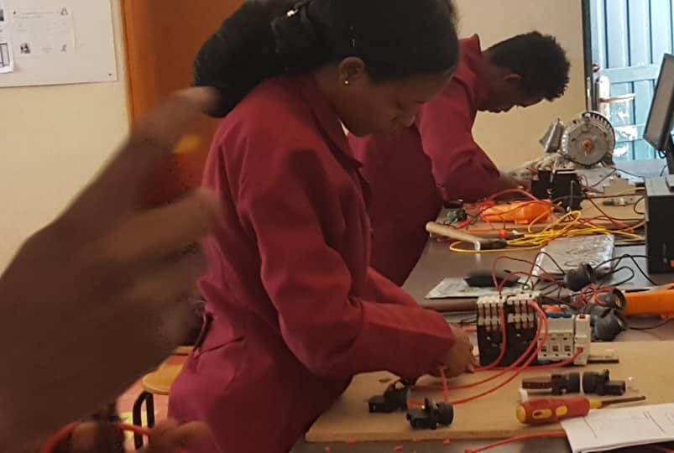
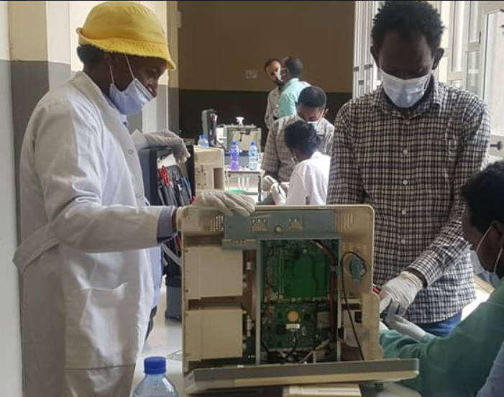
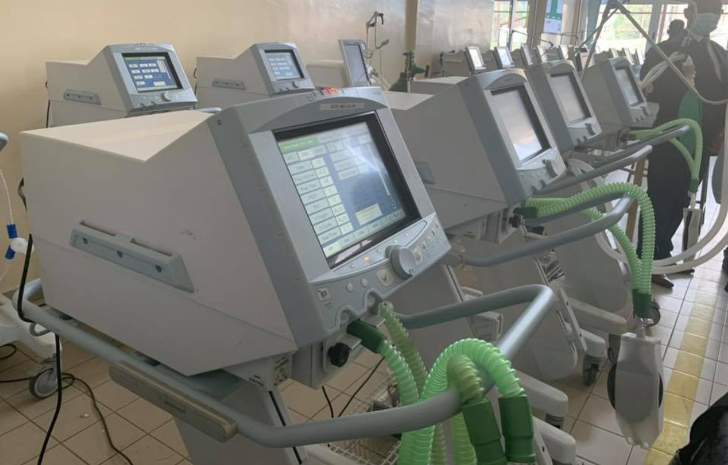
Medical Device Maintenance
Tegbareid Polytechnic College

Slide 9
Refurbished Devices
Delivery to Ethiopia
Purchase the devices
Quote for refurbished devices
Medical Device Suppliers in US

Slide 10
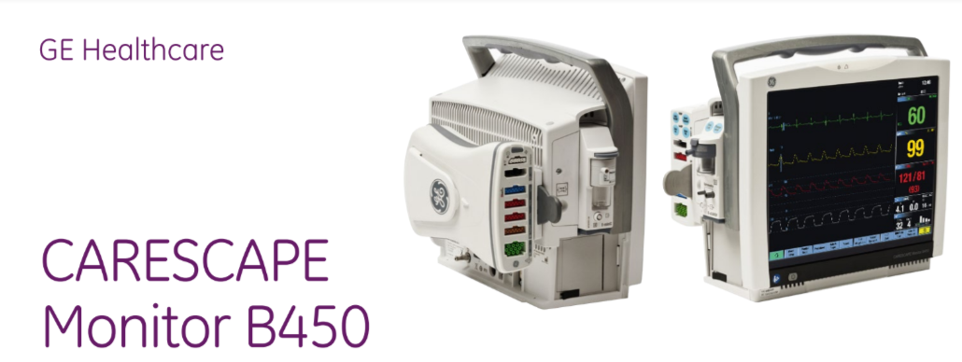
Medical Device Donations

Slide 11
Reliability Testing | UNDP Partnership
LifeBox Grant. | Ethiopian Diaspora Council Partnership
Tegbareid Partnerships | Surveyed doctors in Ethiopia
Key Accomplishments
Notes:
Strategic partnerships eg - Tegbared College, St Paul, St Peter, Eka Kotebe, Rotary club, Distant Relatives, Yegna Sew
Face Shield delivery - In Benashangul, Jijiga, Tikur Ambesa via doctors visiting the regions. 4000 more units expected to be delivered.
Delivery of clothes to people in the quaranteins - Partnership with yenesew and donations, clothes were provided to people in quarantines
Counseling hotline - Worked with doctors on the ground who wanted to provide stress relief to doctors.
Awareness content - After consulting with doctors on the ground, we created content both pdf, video and audio to increase awareness on social media, TV and radio.
Doctor’s survyed - Using google forms, reached out and got over 400+ feedback from doctors on the ground to better understand the problem, get suggestions for solutions and to understand any gaps/needs of the health care workers.

Slide 12


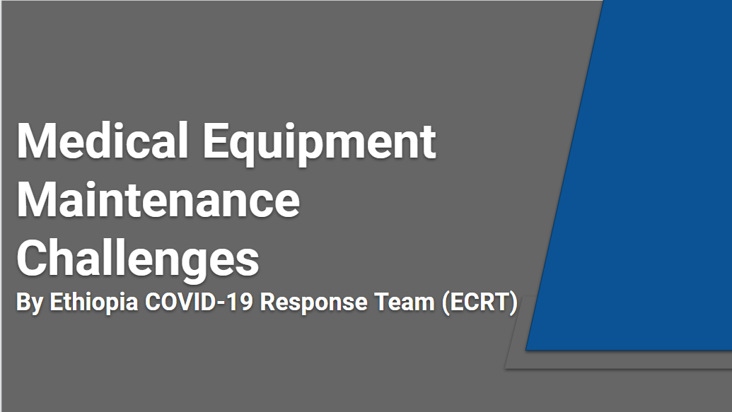
Three Main Tasks

Slide 13
Three Main Tasks

Slide 14
Thank you

